Slide 1

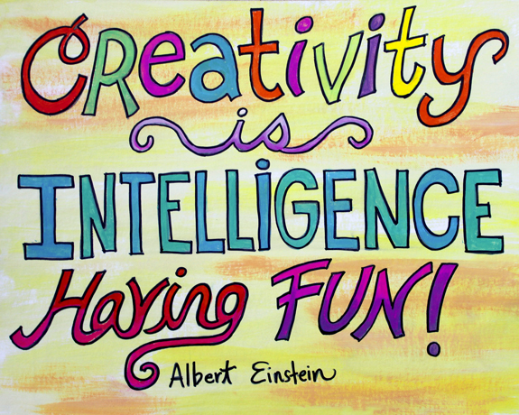
Unit 11
Intelligence and creativity

Slide 2
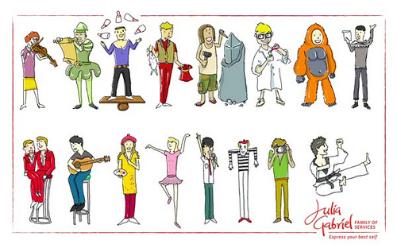
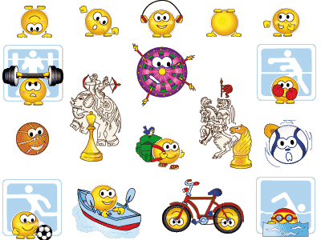
Creativity is the ability to use imagination to produce new ideas or make new things.

Slide 3
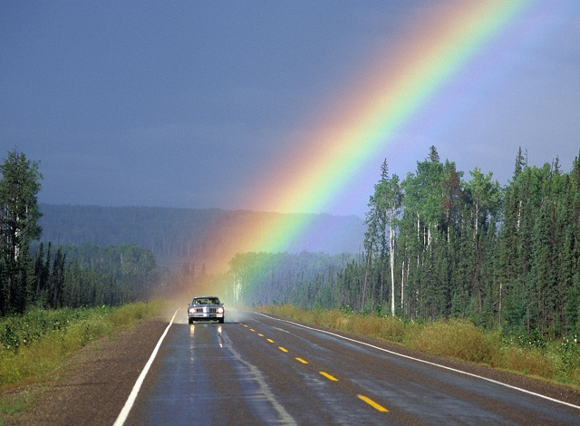

Student’s Book
Page 83

Slide 4
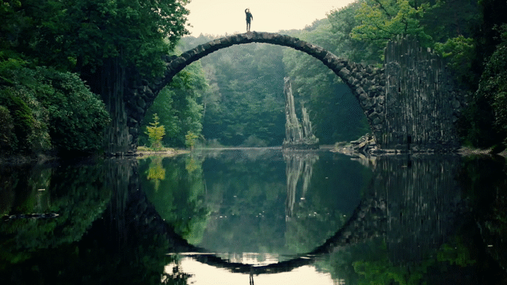
Student’s Book
Page 84

Slide 5




Slide 6
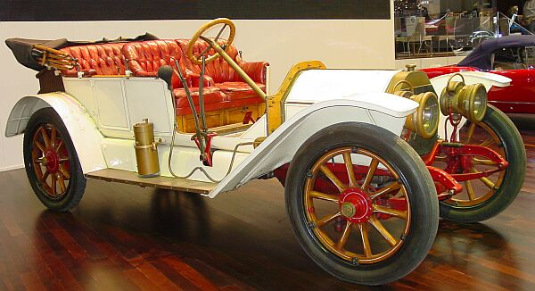
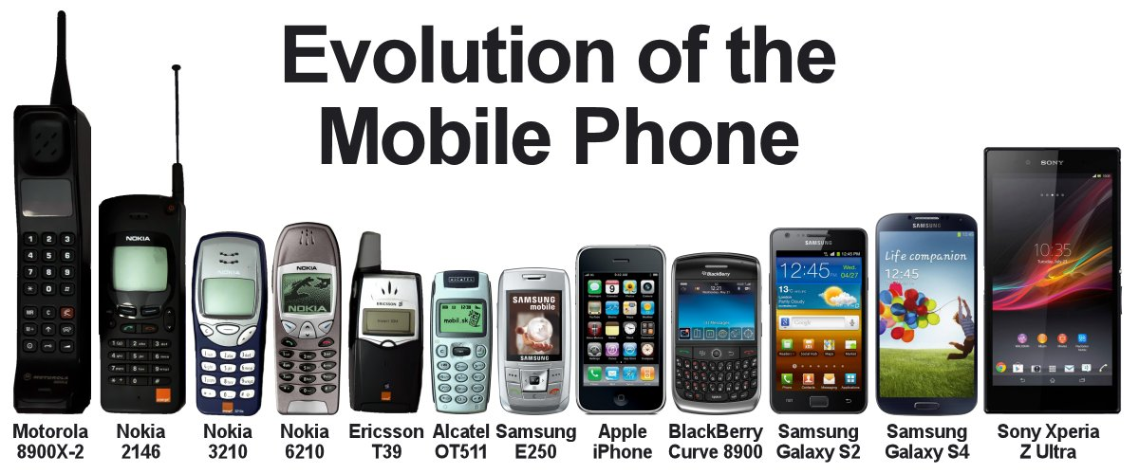
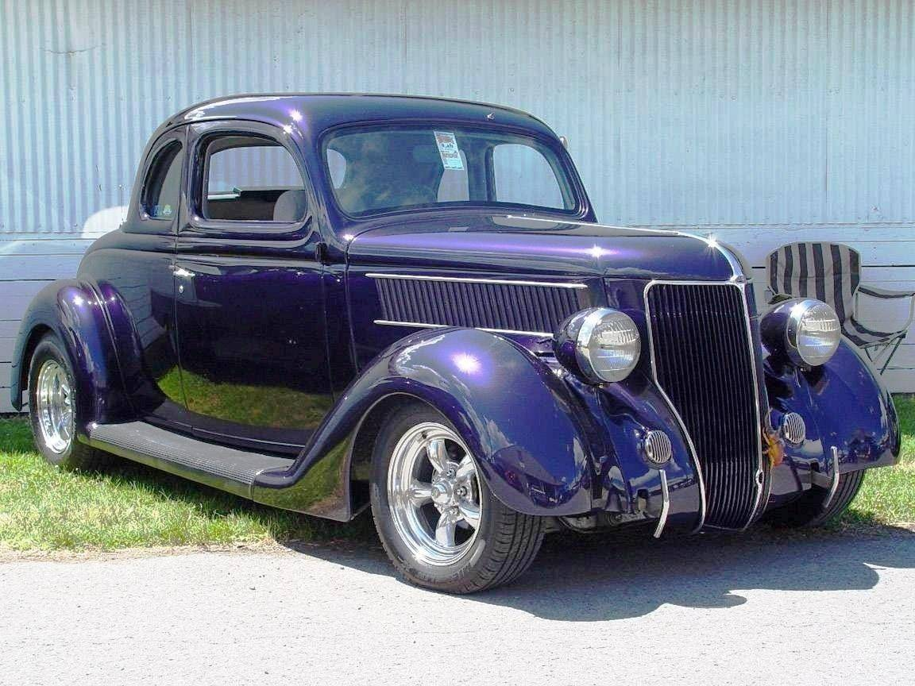
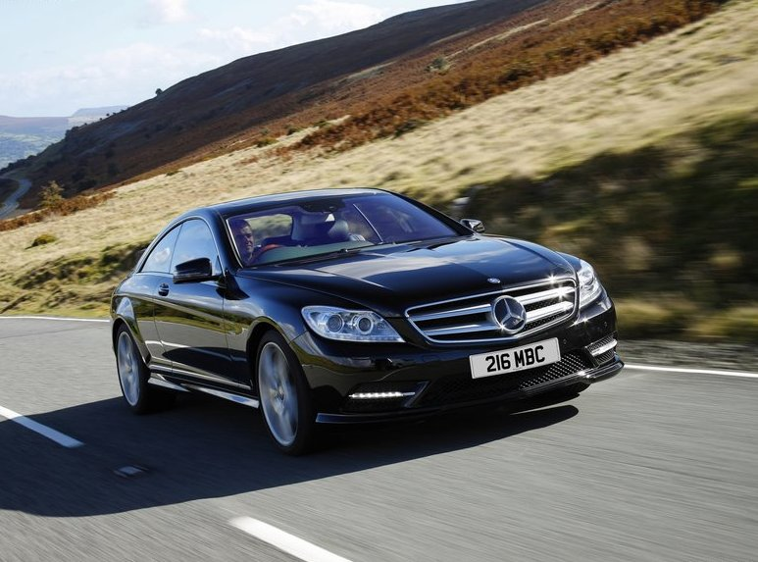
Evolution of ideas
Mobile phones

Slide 7

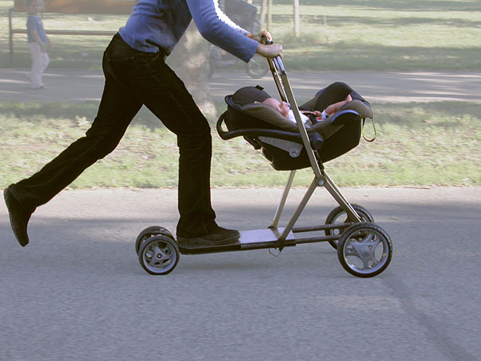
Combining a computer and a network to get Internet
Combining a baby stroller and a scooter

Slide 8
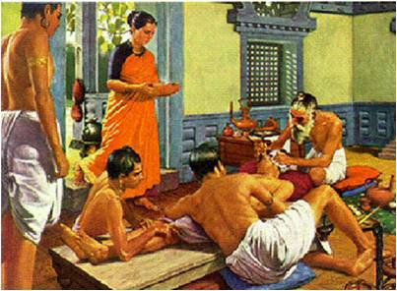
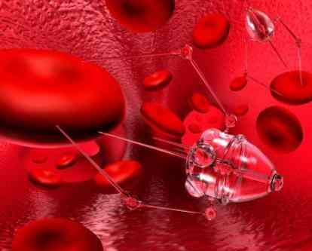
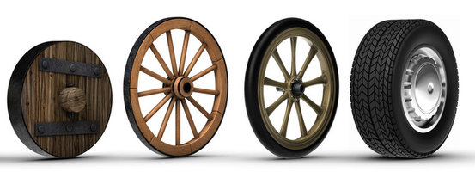

Changing how we do things
The invention of the wheels
Example
Surgical operations involved cutting into the patient. But now doctors can send a small tube with a camera into a person’s body.

Slide 9
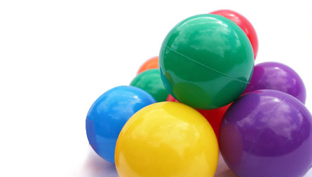

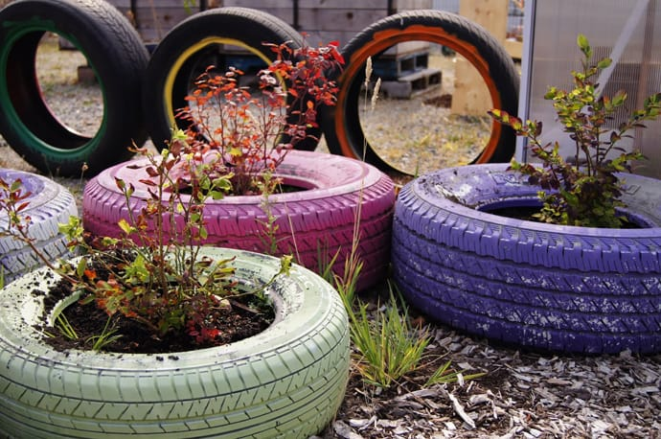
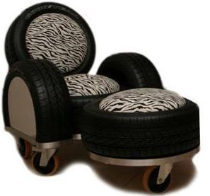

Finding a new use for things
Changing how we use wheels

Slide 10


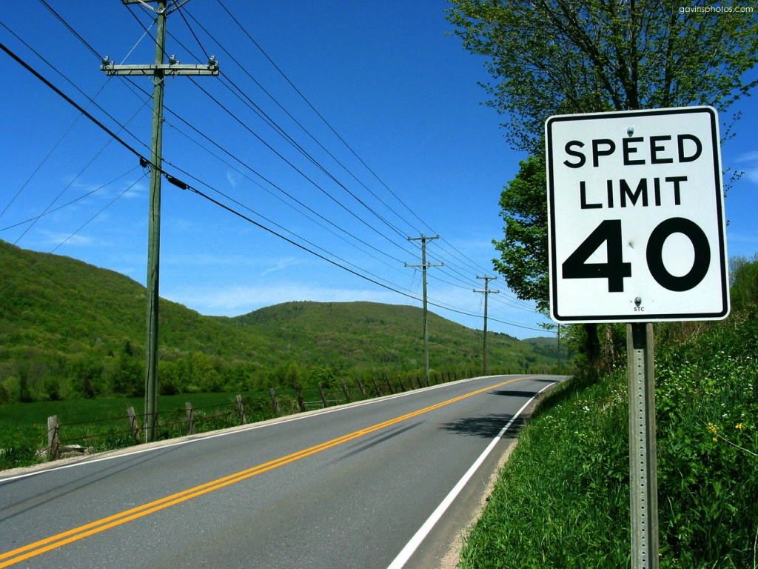


If you take all the road signs away, cars go slower!
Cancelling homework

Slide 11

Thank you

